Slide 1
Frontiers of Network Science
Fall 2023
Class 14 Robustness, the rest of it
(Chapter 8 in Textbook)
based on slides by
Albert-László Barabási
and Roberta Sinatra
Boleslaw Szymanski
www.BarabasiLab.com

Slide 2
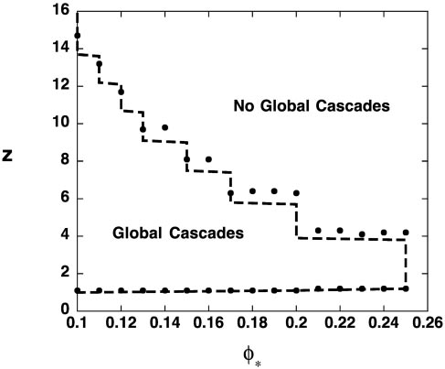
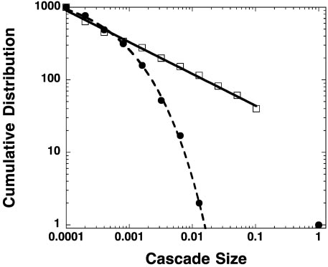
Failure Propagation Model
Initial Setup
Random graph with N nodes
Initially each node is functional.
Cascade
Initiated by the failure of one node.
f_{i} : fraction of failed neighbors of node i. Node i fails if f_{i} is greater than a global threshold φ.
Undercritical
<k>
Critical
Network falls apart (<k>=1)
Overcritical
φ =0.4
● Overcritical
f = 1/2
□ Critical
f = 1/2
f = 0
f = 1/2
f = 1/3
f = 2/3
Erdos-Renyi network
P(S) ~ S ^{−3/2}
D. Watts, PNAS 99, 5766-5771 (2002)

Slide 3
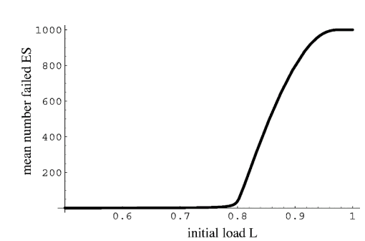
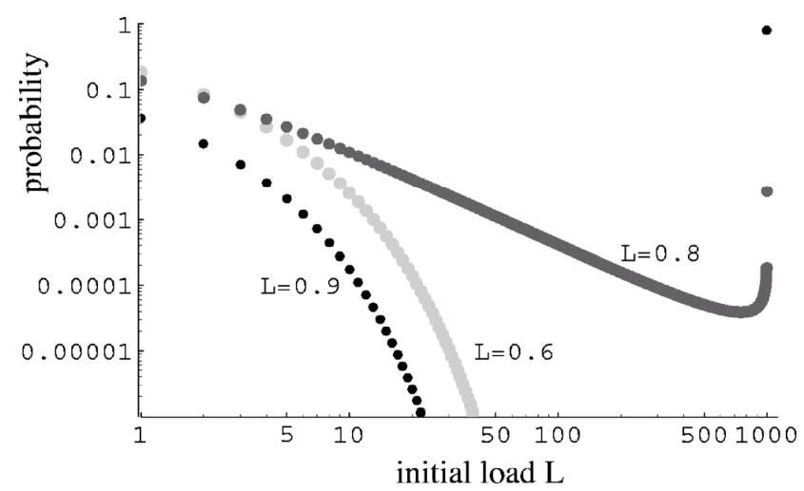
Overload Model
Undercritical
Overcritical
Initial Conditions
N Components (complete graph)
Each components has random initial load L_{i} drawn at random uniformly from [L_{min}, 1].
Cascade
Initiated by the failure of one component.
Component fail when its load exceeds 1.
When a component fails, a ﬁxed amount P is transferred to all the rests.
Critical
L_{min}
Overcritical
L_{i} =0.95
L_{i} =0.8
Critical
Undercritical
P=0.15
L_{i} =0.7
L_{i} =0.9
L_{i} =0.85
L_{i} =1.05
P(S) ~ S ^{−3/2}
I. Dobson, B. A. Carreras, D. E. Newman, Probab. Eng. Inform. Sci. 19, 15-32 (2005)

Slide 4
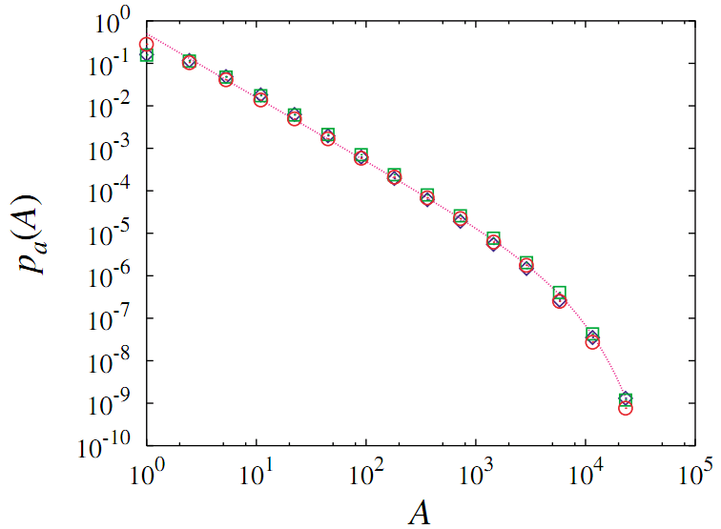
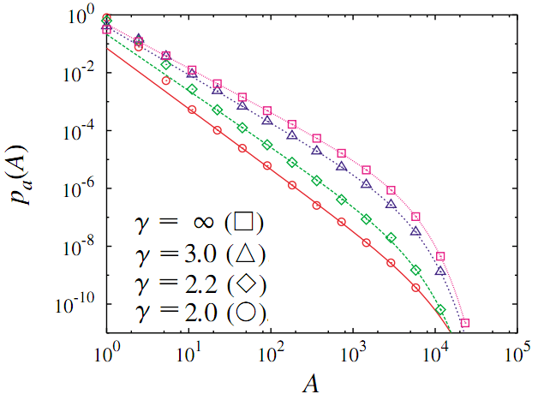
Self-organized Criticality AKA Sandpile Model
Initial Setup
Random graph with N nodes
Each node i has height h_{i} = 0.
Cascade
At each time step, a grain is added at a randomly chosen node i: h_{i} ← h_{i} +1
If the height at the node i reaches a prescribed threshold z_{i} = k_{i}, then it becomes unstable and all the grains at the node topple to its adjacent nodes: h_{i} = 0 and h_{j} ← h_{j} +1
if i and j are connected.
Homogenous case
Scale-free network
Homogenous network: <k²> converges
P(S) ~ S ^{−3/2}
Scale-free network : p_{k} ~ k^{-γ} (2<γ<3)
P(S) ~ S ^{−γ/(γ −1)}
K.-I. Goh, D.-S. Lee, B. Kahng, and D. Kim, Phys. Rev. Lett. 91, 148701 (2003)
Notes:
the avalanche size 𝑆, the number of toppling events in a given avalanche

Slide 5
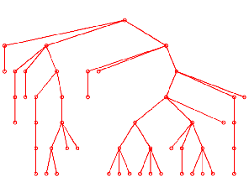
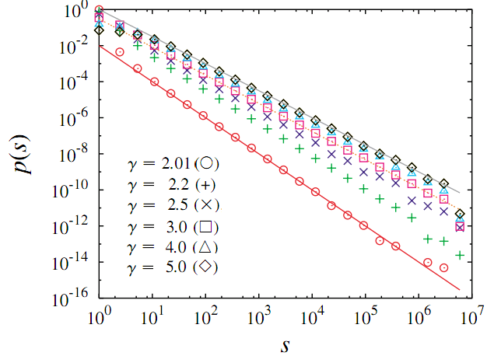
Branching Process Model
Branching Process
Starting from a initial node, each node in generation t produces k number of offspring nodes in the next t + 1 generation, where k is selected randomly from a fixed probability distribution q_{k}=p_{k-1}.
Fix <k>=1 to be critical → power law P(S)
Hypothesis
No loops (tree structure)
No correlation between branches
Narrow distribution: <k²> converged
P(S) ~ S ^{−3/2}
Fat tailed distribution: q_{k} ~ k^{-γ} (2<γ<3)
P(S) ~ S ^{−γ/(γ −1)}
K.-I. Goh, D.-S. Lee, B. Kahng, and D. Kim, Phys. Rev. Lett. 91, 148701 (2003)

Slide 6
Short Summary of Models: Universality
Models | Networks | Exponents
Failure Propagation Model | ER | 1.5
Overload Model | Complete Graph | 1.5
BTW Sandpile Model | ER/SF | 1.5 (ER) γ/(γ - 1)(SF)
Branching Process Model | ER/SF | 1.5 (ER) γ/(γ - 1)(SF)
Universal for homogenous networks
P(S) ~ S ^{−3/2}
Same exponent for percolation too (random failure, attacking, etc.)

Slide 7
Explanation of the 3/2 Universality
Simplest Case: q₀ = q₂ = 1/2, <k> = 1
S: number of nodes
X: number of open branches
½ chance
S = S+1
X = X -1
S = 2, X = 0
k= 0
S = 1
X = 1
S = S+1
X = X+1
S = 2, X = 2
½ chance
k=2
X
X >0, Branching process stops when X = 0
S
Dead

Slide 8
Explanation of the 3/2 Universality
X
S
Dead
Equivalent to 1D random walk model, where X and S are the position and time , respectively.
Question: what is the probability that X = 0 after S steps?
First return probability ~ S^{-3/2}
M. Ding, W. Yang, Phys. Rev. E. 52, 207-213 (1995)

Slide 9
Size Distribution of Branching Process (Cavity Method)
S₁
S₁
S₂
k = 0
k = 1
k = 2
S = 1
S = 1+S₁
S = 1+S₁+S₂
K.-I. Goh, D.-S. Lee, B. Kahng, and D. Kim, Physica A 346, 93-103 (2005)

Slide 10
Solving the Equation by Generating Function
Definition:
G_{S}(x) = Σ_{S=0} P(S)x^{S}
G_{k}(x) = Σ_{k=0} q_{k}x^{k}
Property:
G_{S}(1) = G_{k}(1) = 1
G_{S}’(1) = <S>, G_{k}’(1) = <k>
Phase Transition
<S> = G_{S}’(1) = 1+ G_{k}’(1) G_{S}’(1) = 1 + <k> <S>, then
<S> = 1/(1- <k>)
The average size <S> diverges at <k>_{c} = 1

Slide 11
Finding the Critical Exponent from Expansion
Definition:
G_{S}(x) = Σ_{S=0} P(S)x^{S}
G_{k}(x) = Σ_{k=0} q_{k}x^{k}
Theorem:
If P(k) ~ k^{-γ} (2<γ<3), then for δx < 0, |δx| << 1
G(1+ δx) = 1 + <k>δx + <k(k-1)/2> (δx)² + … + O(|δx|^{γ - 1})
P(S) ~ S ^{−α},1< α < 2
G_{S}(1+ δx) ≈ 1 + A|δx|^{α -1}
Homogenous case: <k²> converged <k> = 1, <k²> < ∞
G_{k}(1+ δx) ≈ 1 + δx + Bδx²
Inhomogeneous case: <k²> diverged
<k> = 1, q_{k} ~ k^{-γ} (2<γ<3)
G_{k}(1+ δx) ≈ 1 + δx + B|δx|^{γ - 1}

Slide 12
Critical Exponent for Homogenous Case
Homogenous case
G_{k}(1+ δx) ≈ 1 + δx + Bδx²
G_{S}(1+ δx) ≈ 1 + A|δx|^{α -1}
G_{S}(x) = xG_{k}(G_{S}(x))
G_{S}(x) ≈ 1 + A|δx|^{α -1}
xG_{k}(G_{S}(x)) ≈ (1+δx)[1+ (G_{S}(1+δx)-1) + B (G_{S}(1+δx)-1)²]
≈ (1+δx)[1+ A|δx|^{α -1} + AB|δx|^{2α -2}]
= 1 + A|δx|^{α -1} + AB|δx|^{2α -2} + δx + O(|δx|^{α})
The lowest order reads AB|δx|^{2α -2} + δx = 0, which requires
2α -2 = 1and A = 1/B. Or,
α = 3/2

Slide 13
Critical Exponent for Inhomogeneous Case
Inhomogeneous case
G_{k}(1+ δx) ≈ 1 + δx + B|δx|^{γ - 1}
G_{S}(1+ δx) ≈ 1 + A|δx|^{α -1}
G_{S}(x) = xG_{k}(G_{S}(x))
G_{S}(x) ≈ 1 + A|δx|^{α -1}
xG_{k}(G_{S}(x)) ≈ (1+δx)[1+ (G_{S}(1+δx)-1) + B |G_{S}(1+δx)-1|^{γ -1}]
≈ (1+δx)[1+ A|δx|^{α -1} + AB|δx|^{(α -1)(γ -1)}]
= 1 + A|δx|^{α -1} + AB|δx|^{(α -1)(γ -1)} + δx + O(|δx|^{α})
The lowest order reads AB|δx|^{(α -1)(γ -1)} + δx = 0, which requires
(α -1)(γ -1) = 1and A = 1/B. Or,
α = γ/(γ −1)

Slide 14
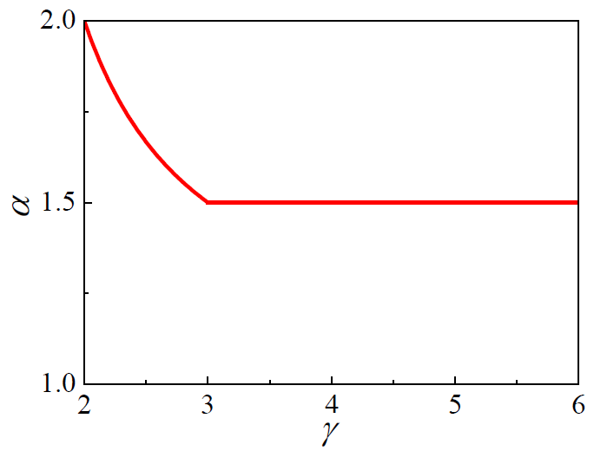
Comparing the Prediction with the Real Data
Blackout
Blackout
Source | Exponent | Quantity
North America | 2.0 | Power
Sweden | 1.6 | Energy
Norway | 1.7 | Power
New Zealand | 1.6 | Energy
China | 1.8 | Energy
Earthquake α ≈ 1.67
I. Dobson, B. A. Carreras, V. E. Lynch, D. E. Newman, CHAOS 17, 026103 (2007)
Y. Y. Kagan, Phys. Earth Planet. Inter. 135 (2–3), 173–209 (2003)

